Slide 1
Managing your Menopause – group
Barnet PCN 1W
Notes:
https://www.ncbi.nlm.nih.gov/pmc/articles/PMC6610461/#bibr125-2045125319859973

Slide 2
Group agreement
Confidentiality
Housekeeping
Managing challenging thoughts and feelings
Respect for others
Self-disclosure
Anything else?

Slide 3
Mindful breathing exercise
Breathing exercise
To reduce stress, anxiety and feelings of panic
Practise daily to see the benefits
We will do this at the start and end of each group session
Notes:
Box breathing exercise

Slide 4
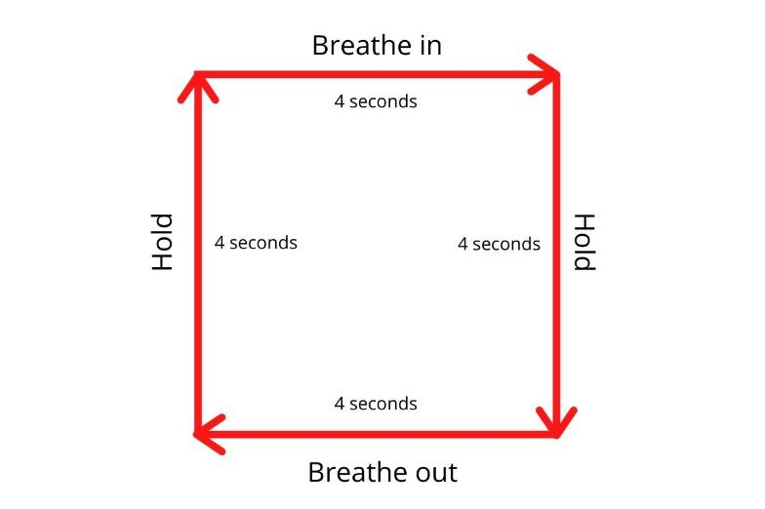
Box breathing technique

Slide 5
Aims of the group
To gain an understanding about peri/menopause
To promote lifestyle changes (e.g., wellbeing-focused)
To educate the link between menopause and mental health
To develop strategies to manage symptoms
To learn about HRT and accessing treatment
To create a safe space to openly talk
To actively contribute and engage in discussions – this is a peer-led group

Slide 6
What is the menopause?
Menopause is a point in time 12 months after a woman's last period.
The years leading up to that point, when women may have changes in their monthly cycles, hot flashes, or other symptoms, are called the menopausal transition or perimenopause.
The menopausal transition most often begins between ages 45 and 55.
It usually lasts about seven years but can be as long as 14 years.
The duration can depend on lifestyle factors such as smoking, age it begins, and race and ethnicity.
Notes:
Menopause is when your periods stop due to lower hormone levels. Perimenopause is when you have symptoms before your periods have stopped. You reach menopause when you have not had a period for 12 months.

Slide 7
Types of menopause
Typical or ‘Natural’ menopause – 4 stages
Premenopause is the time between a woman’s first period and onset of perimenopause. Lasts on average of 30-35 years.
Perimenopause is the transitional phase right before menopause and can last on average between 4-10 years.
Menopause is when you have no periods of 12 consecutive month.
Postmenopause is the day after menopause.

Slide 8
Group outline
Week 1 – introducing ourselves, completing the mental wellbeing questionnaire, brief overview of the menopause.
Week 2 – Menopausal symptoms and management
Week 3 – Strategies/Techniques to manage symptoms
Week 4 – The role of diet and exercise (Dietitian and Physiotherapy presentation)
Week 5 – HRT and mindfulness activity
Week 6 – Feedback and evaluation session

